Slide 1

COIT11241 Wk9 A2 Attack
Jake Kenealy
12197775

Slide 2
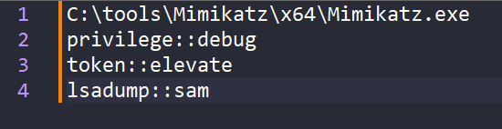
Attack 1
One of the attacks that BlackCat is known to make is LSASS credential dumping. One of the way they do this is using the tool Mimikatz. The command can be categorised as T1003.001 OS Credential Dumping: LSASS Memory.
(Delpy, 2023) (Red Canary, 2023)

Slide 3
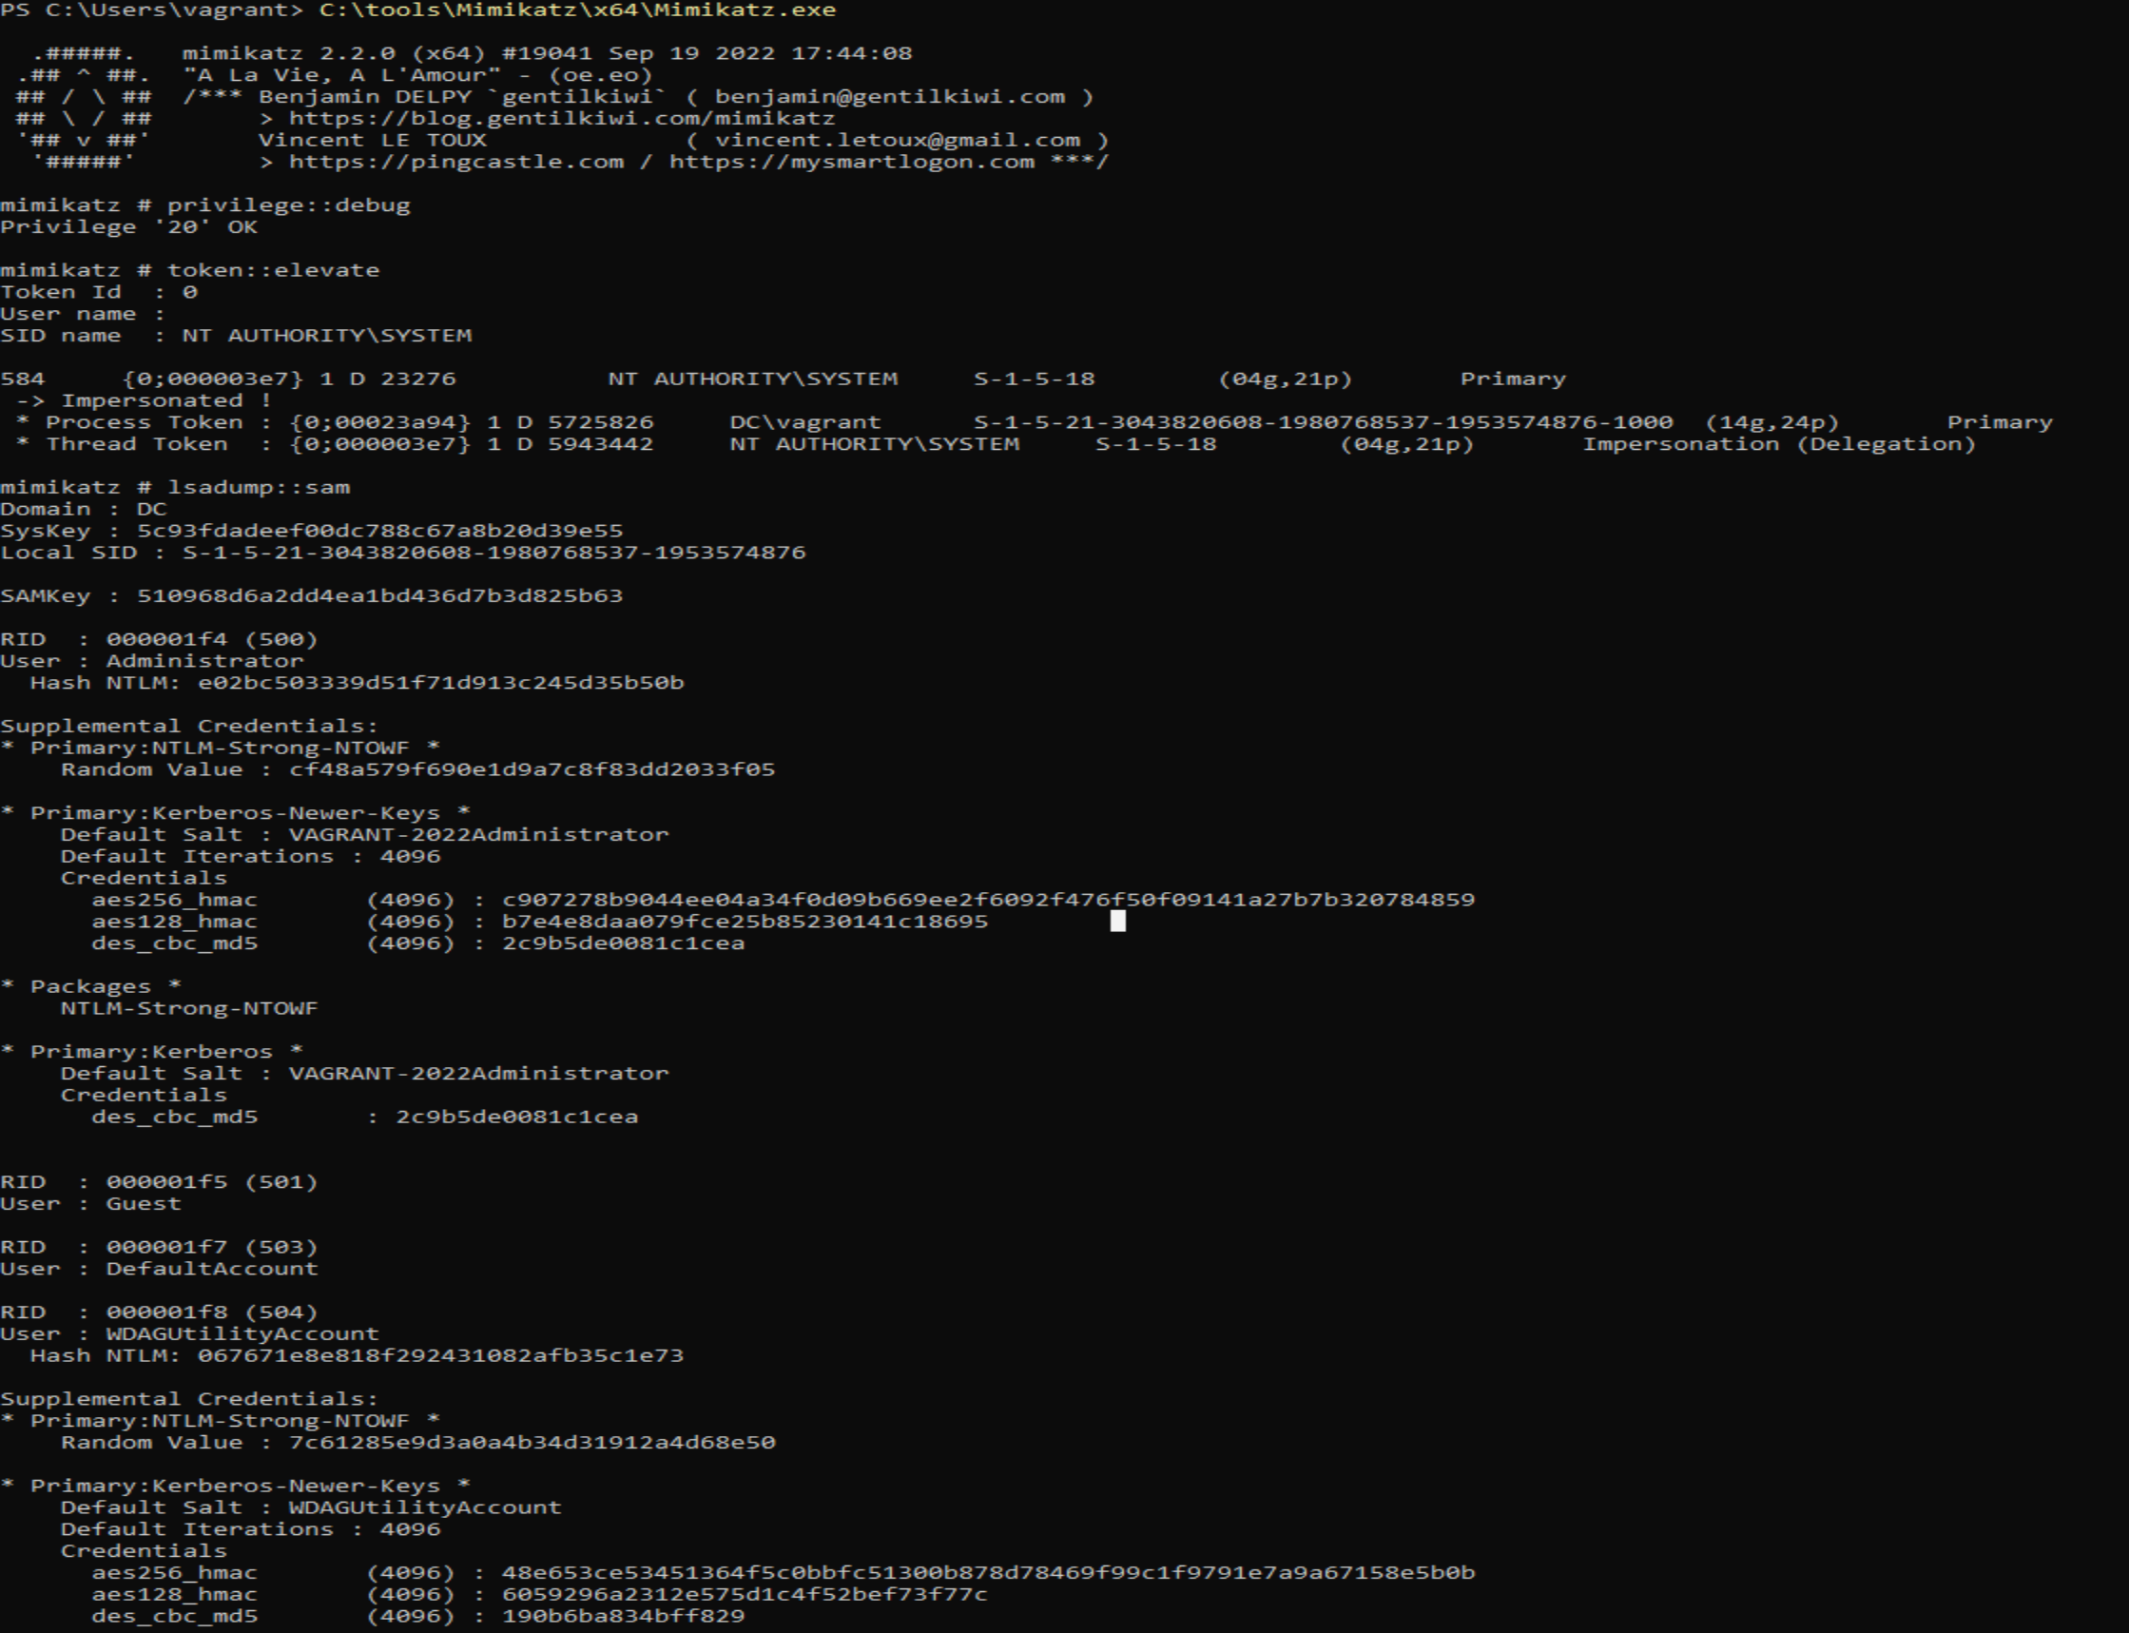
Results of Attack 1

Slide 4
Attack 2
Another attack used by BlackCat is testing parts of the firewall. This command is used to test for which ports are open outbound. This commandThis command can be categorised as T1016 System Network Configuration Discovery.
(Red Canary, 2023) (Bullock, 2016)

Slide 5
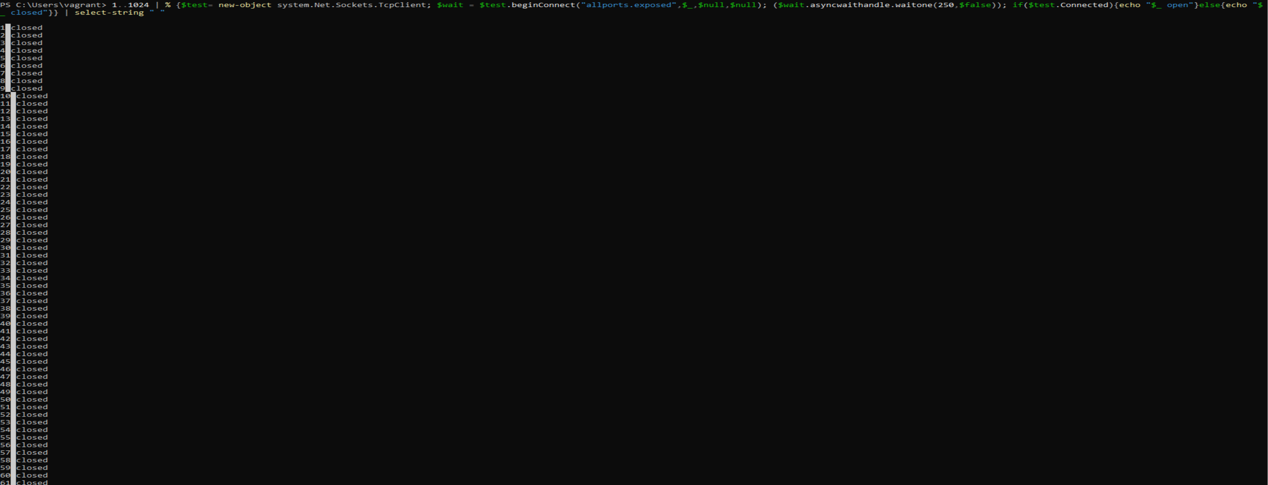
Results of Attack 2

Slide 6
Attack 3
Blackcat uses this attack as part of its lateral movement. It changes the port used by RDP and allows connections through that port. We can categorise this attack as T1021.001 Remote Services: Remote Desktop Protocol.
(Red Canary, 2023)

Slide 7
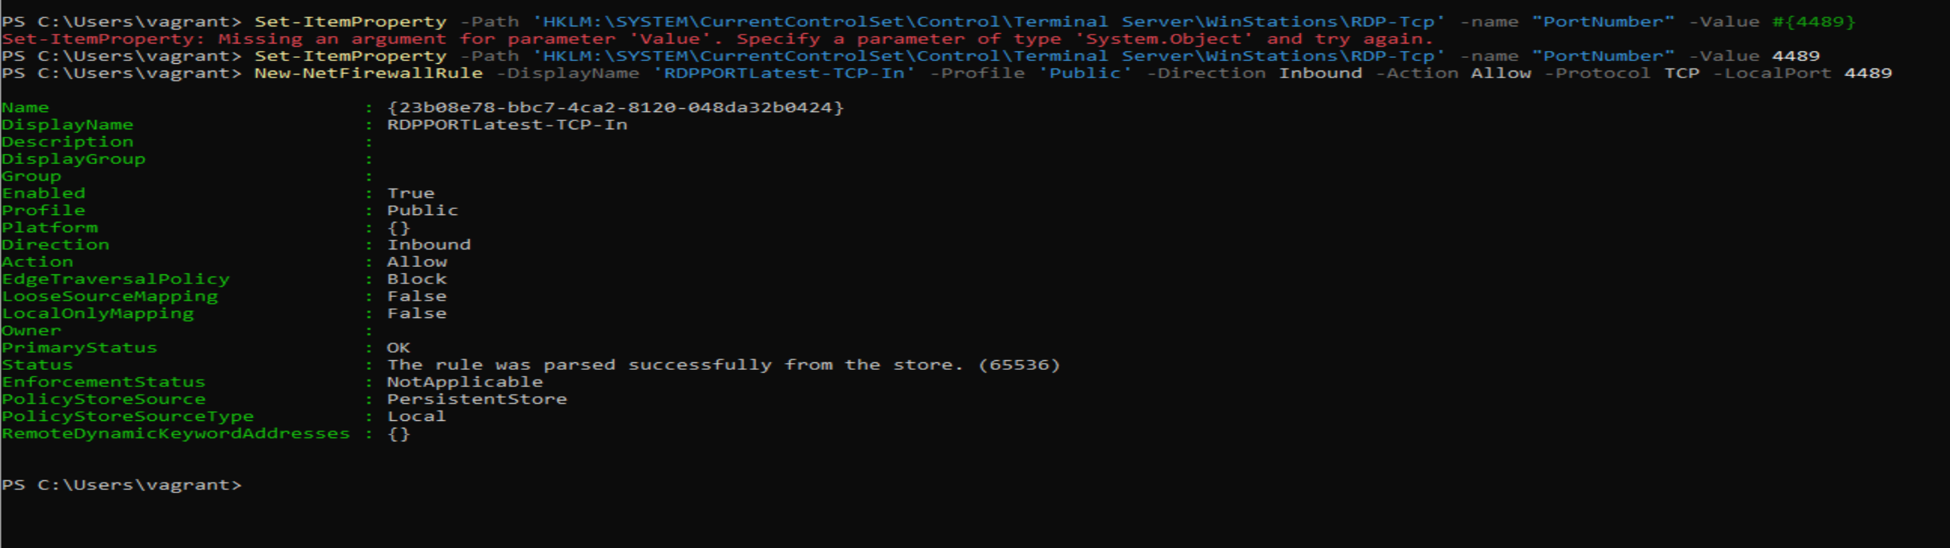
Results of Attack 3

Slide 8
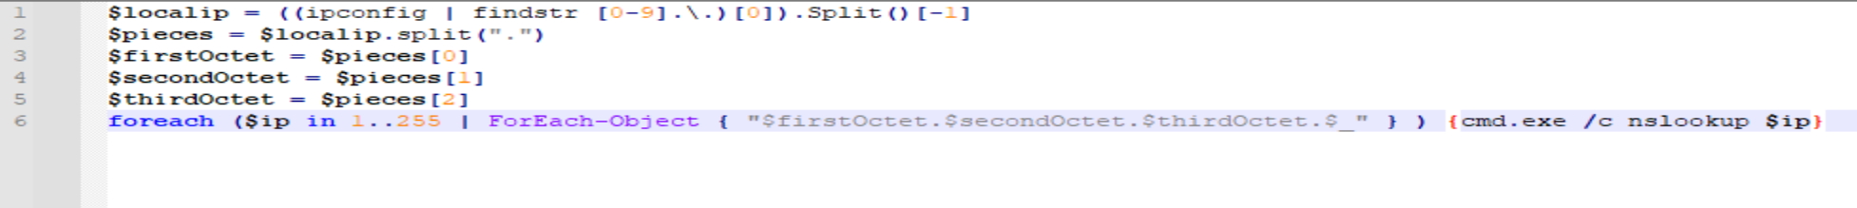
Attack 4
The next attack uses nslookup. This checks for the first adapter’s IP on the machine it is run on and searches for every other machine on the network with a variation in only the last octet. We can categorise this attack as T1018 Remote System Discovery.

Slide 9
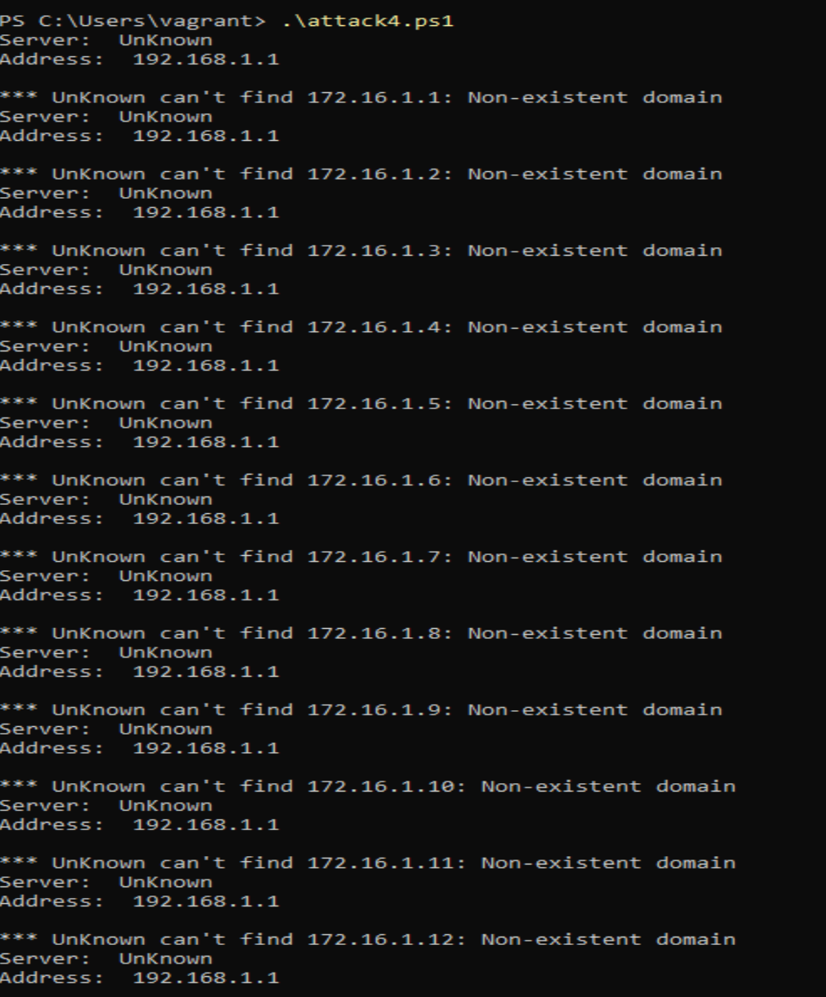
Results of Attack 4
My test obviously is not successful because my DC VM is not domain joined.

Slide 10
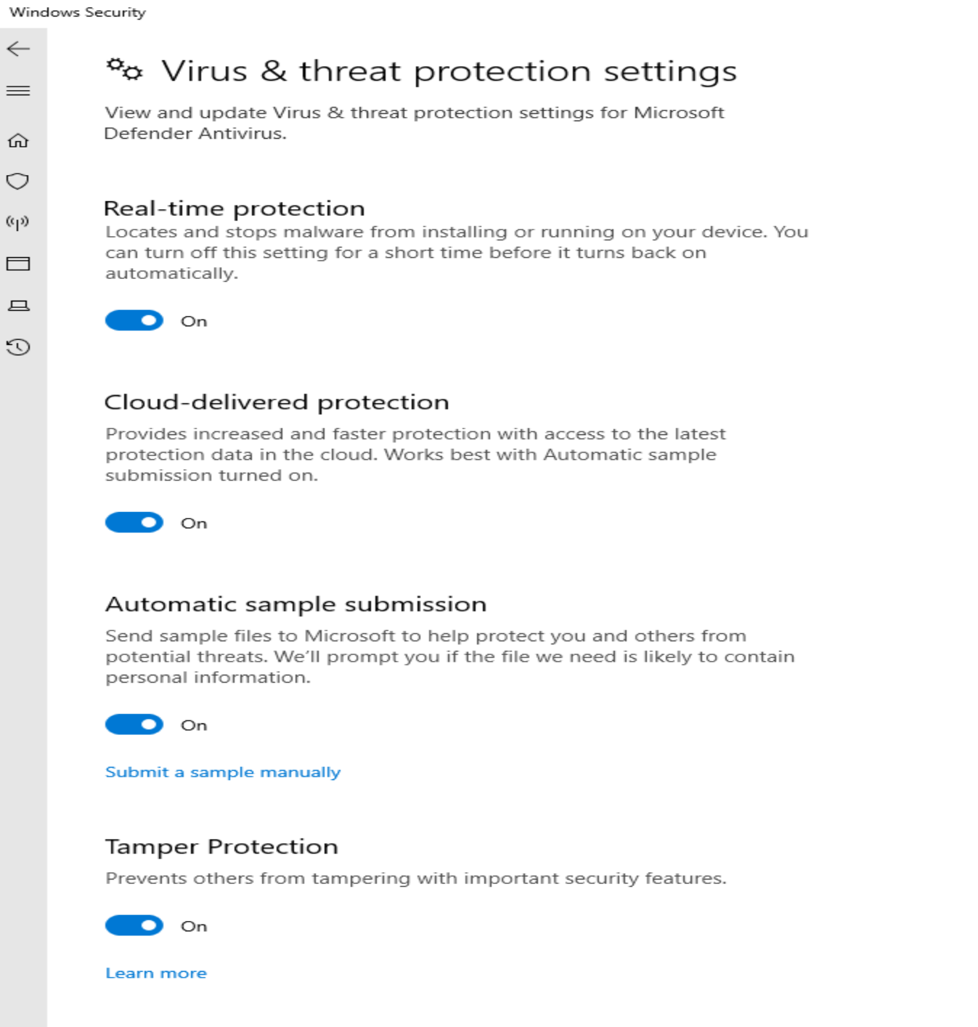
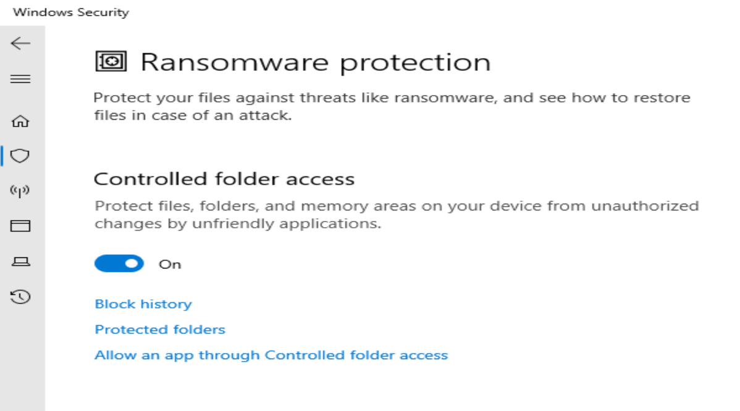
Prevention of Attack 1
To prevent against Attack 1, an administrator can user Attack Surface Reduction rules in conjunction with Windows security/defender. This will ensure that malicious entities such as mimikatz are unable to run.
(Microsoft, 2023)

Slide 11
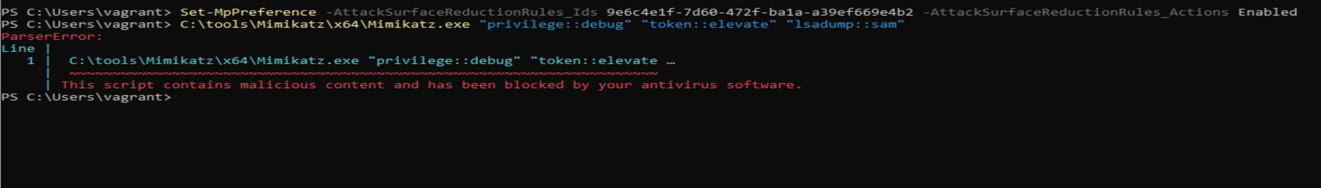
Results of Prevention 1

Slide 12
Prevention of Attack 4
To stop scripts being run with powershell an administrator has the ability to change the execution policy. Setting this to restricted means that no user can run scripts without changing the execution policy first.

Slide 13
Results of Prevention 2

Slide 14
References
Bullock, B. (2016, April 6). Poking Holes in the Firewall: Egress Testing With AllPorts.Exposed. Retrieved from Black Hills Information Security: https://www.blackhillsinfosec.com/poking-holes-in-the-firewall-egress-testing-with-allports-exposed/
Delpy, B. (2023, July 24). module ~ lsadump. Retrieved from mimikatz: https://github.com/gentilkiwi/mimikatz/wiki/module-~-lsadump
Microsoft. (2023, August 4). Attack surface reduction (ASR) rules reference. Retrieved from Microsoft Learn: https://learn.microsoft.com/en-us/microsoft-365/security/defender-endpoint/attack-surface-reduction-rules-reference?view=o365-worldwide#block-credential-stealing-from-the-windows-local-security-authority-subsystem
Red Canary. (2023, September 24). Retrieved from Atomic Red Team: https://atomicredteam.io/lateral-movement/T1021.001/#atomic-test-1---rdp-to-domaincontroller
Red Canary. (2023, September 24). OS Credential Dumping: LSASS Memory. Retrieved from Atomic Red Team: https://atomicredteam.io/credential-access/T1003.001/
Red Canary. (2023, September 24). System Network Configuration Discovery. Retrieved from Atomic Red Team: https://atomicredteam.io/discovery/T1016/
Chat.openai.com ChatGPT / September 25, 2023 version (Used the prompts: https://chat.openai.com/share/6942ecaa-05da-4d2a-b081-d44211ea3868)

Slide 15
Github Link
https://github.com/Jake-Kenealy/COIT11241---Wk9Attack.git

